Slide 1
Intro to AI for Medicine
Lec 1: Intro

Slide 2
Welcome!
Notes:
Thanks for going along with my crazy idea for a class
I know it’s a privilege to get the attention of my classmates to talk about anything for 1h
I’m not taking it lightly and I really want to do a good job with this class

Slide 3
Today’s Agenda
Logistics, mindset, goals
History of AI up to 1990
Brief lecture today – expect 45 min

Slide 4
Logistics - Format
Lectures 2x weekly, Monday, Wednesday
7pm
Always on zoom
Office hours for 1 hour after class
Notes:
(camera can be off, muted)

Slide 5
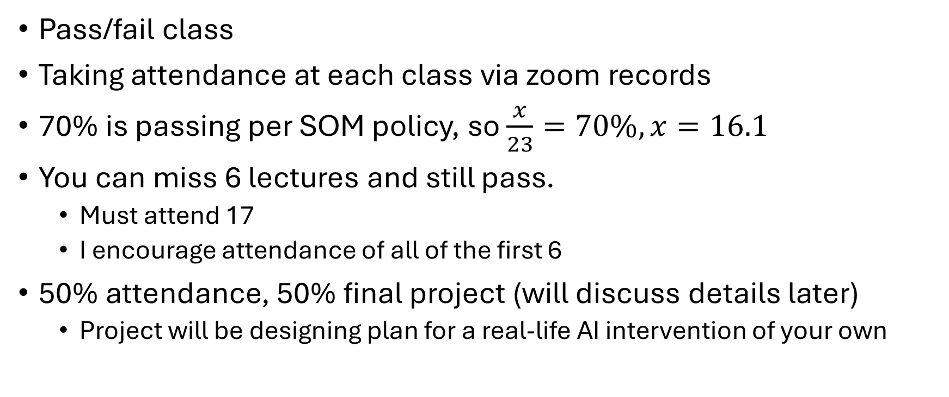
Logistics - Grading
Pass/fail class
Taking attendance at each class via zoom records
70% is passing per SOM policy, so $\frac{x}{23}=70\%, x=16.1$
You can miss 6 lectures and still pass.
Must attend 17
I encourage attendance of all of the first 6
50% attendance, 50% final project (will discuss details later)
Project will be designing plan for a real-life AI intervention of your own
Notes:
Camera/mic can be off

Slide 6
Lecture Schedule
Foundations Module: 8 lectures
Focuses on how AI works
Mathematical
Will always have a “clinical correlate”
Applications Module: 15 lectures
Tech applications (LLMs, Computer Vision, Interpretability)
Practical applications (AI infrastructure, medicolegal concerns, business)
Ethical applications (fairness, bias, ethics, etc)
Will sprinkle in general CS knowledge PRN
Notes:
Don’t freak out, I will make sure you get through it.
It’s absolutely necessary to have a proper understanding of AI.

Slide 7
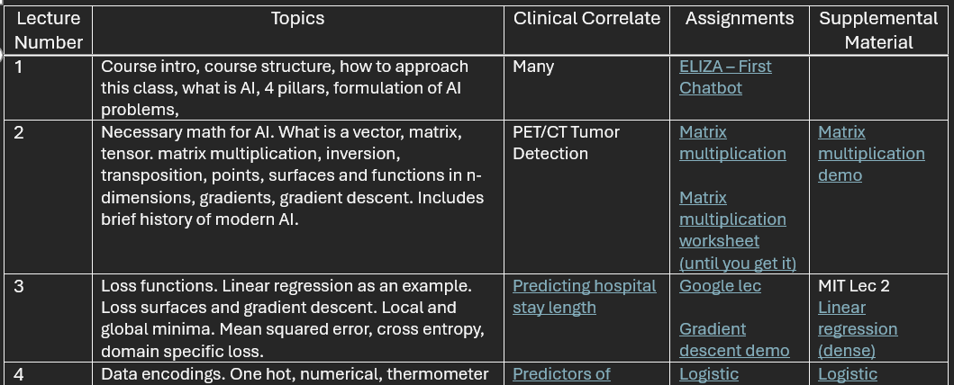
Homework
Refer to the weekly schedule for readings

Slide 8
Textbooks
Math Textbook: MIT 6.036
Ethics Textbook: FairML Book
Barocas, Solon, Moritz Hardt, and Arvind Narayanan. Fairness and Machine Learning: Limitations and Opportunities. MIT Press, Dec. 2023.
https://fairmlbook.org/
No readings required, just a source for extra info if you want to dig deeper
At times a source for supplemental material

Slide 9
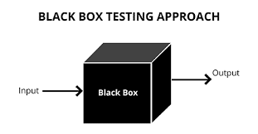
Approach to this class
Patient has + swab for Gonorrhea
Treat with
Ceftriaxone +
doxycycline
But why?

Slide 10
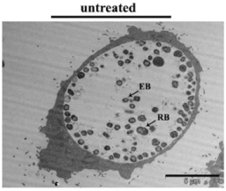
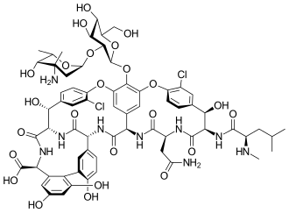
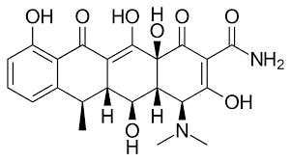
Approach to this class
Look inside the box!
Chlamydia is intracellular – won’t be detected unless released
Treat like it’s there
Treat with an antibiotic that’s small and nonpolar, easily crosses cell membranes and can get intracellular
Treat chlamydia with doxycycline
doxycycline
Vancomycin

Slide 11
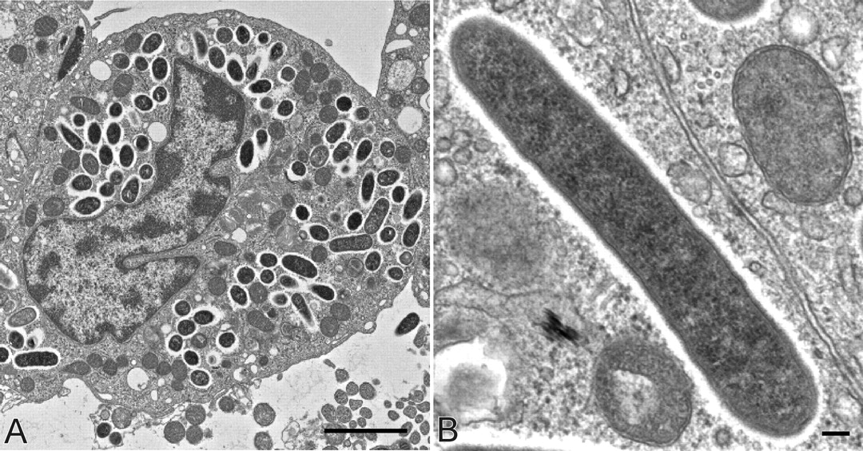
Approach to this class
Rickettsia Rickettsii
What would you treat with?
Treat RMSF with Doxycycline.

Slide 12
Approach to this class
Give information to make decisions on your own
Who knows what technology will be out there in 2, 5, 10 years.
I want to give you tools to tackle new problems
Can learn way more info in much less time
Sticks better too
Teach you another way of thinking about problems, including in medicine
Notes:
This goes back to the different mindset, but it’s something that will help your understanding here and moving forward

Slide 13
My Goals For The Class
Take it seriously and do a good job
01
Make it meaningful to your future careers
Adapt in real time to make this happen
Teach you a new way of approaching problems and thinking
02
Prepare you for any innovations that happen in your career
03
Break down difficult concepts into understandable words – this class should never feel overwhelming
04
Give frameworks and spot trends to give you intuition
05
You will be shocked how far we will get in 3 months!

Slide 14
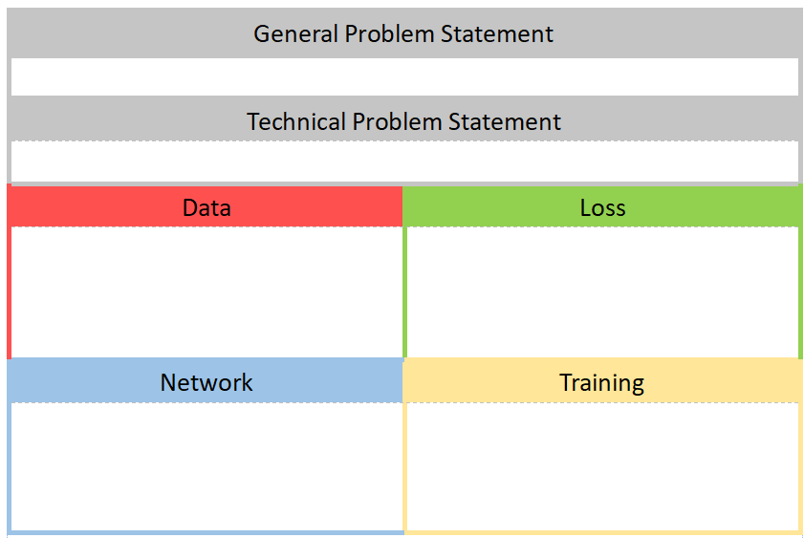
4 Pillars Diagram
Notes:
Framework for breaking down modern AI

Slide 15
Your Goals Should Be
Don’t treat this class as a joke – try to learn something
Take breaks, absences as you need them
Be open minded to learning from many disciplines
Try to imagine how your practice and research can adapt
Give feedback!

Slide 16
Tips for Success in This Class
You get out what you put in
This class is truly multidisciplinary, so learn to think like an engineer
Ask lots of questions!
Give feedback in real time
Notes:
Take ownership and apply to your own career
Dig deeper in topics that confuse and interest you
We have time!
Bottom up understanding
Medicine much more often is top down
Understand things start to finish
Someone thought about and built everything
If I can’t explain it, I will help you and that’s a chance for me to learn too

Slide 17
What is AI?

Slide 18
What is AI? (Two More Definitions)
Artificial intelligence (AI) is the capability of computational systems to perform tasks typically associated with human intelligence, such as learning, reasoning, problem-solving, perception, and decision-making.
It is a field of research in computer science that develops and studies methods and software that enable machines to perceive their environment and use learning and intelligence to take actions that maximize their chances of achieving defined goals.

Slide 19
What is AI?
Approximation based on iterative improvement of operations performed on data based on a mathematical definition of succss
Maybe by the end, you’ll agree with me.

Slide 20
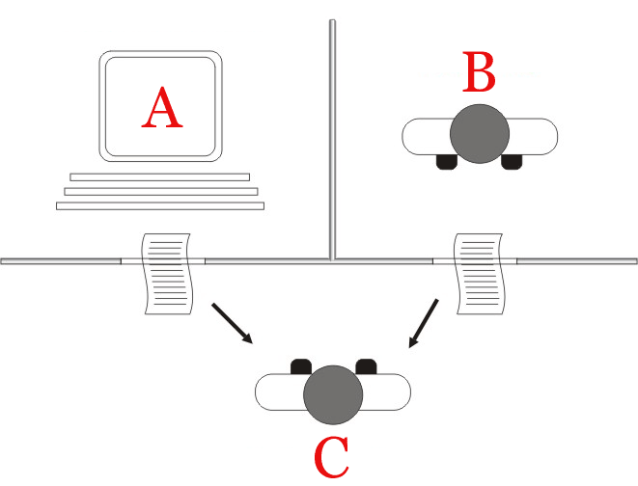
What is AI? Turing Test
Notes:
In 1950s, father of computing alan turing devised the task of determining whether a text was human or AI generated.
Faced scrutiny because intelligence need not always resemble the form of a human

Slide 21
What is AI?
You know it when you see it?
No widely accepted definition.
For the purposes of this class:
Any computer assisted decision making system

Slide 22
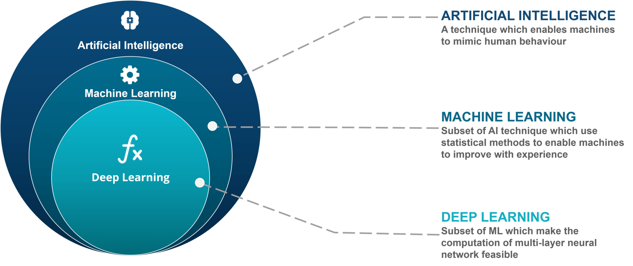
AI vs ML
Notes:
ML is the most successful subfield of AI
Essentially synonymous for modern applications
DL is an advanced application of ML
For the rest of this class, we’ll talk about how we got from AI to ML.

Slide 23
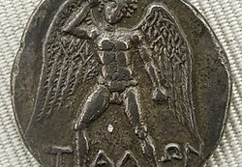
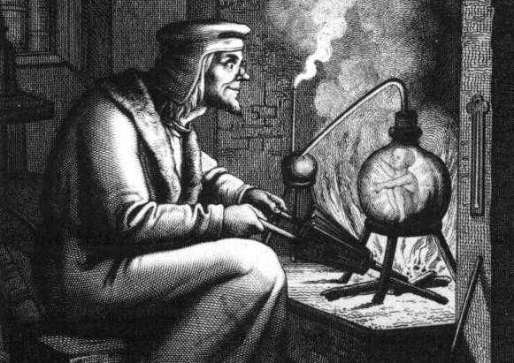
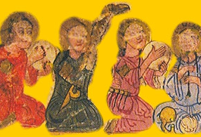
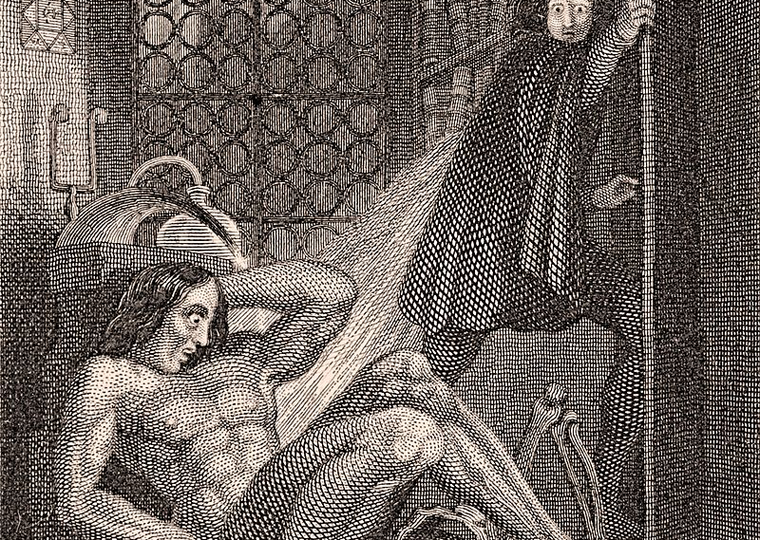
Brief history of AI
Ancient myths and legends:
Talus
The Golem
Automata
Frankenstein
Notes:
Talos: bronze guardian of Crete. Walks the perimeter, defending it from invaders
The golem: A clay figure given the gift of intelligence by inserting an inscribed piece of paper
Al Jazari’s automata: figures that could answer questions posed to them
Figures imbued with life: Frankenstein
Of course, much more than can be shown here
People have been dreaming of man made intelligence throughout history.

Slide 24
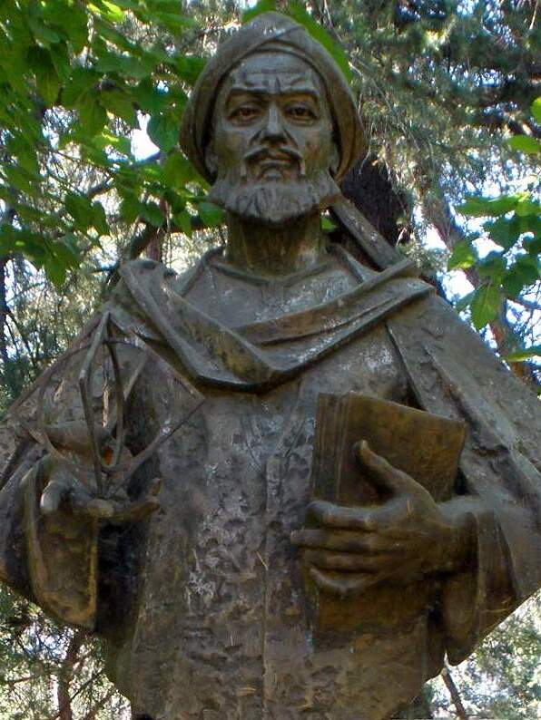
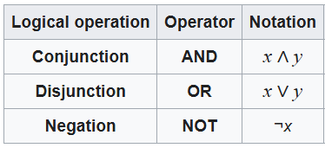
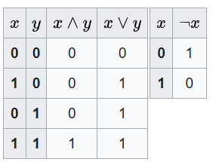
Brief History of AI
Great logicians:
Al Khwarizmi
Leibniz
Formalization of the laws of logic
Boolean logic
Turing’s machine
Limitations to machine representation of logic
Within that, all problems mathematically representable
Outlined the theoretical capabilities of a computer
Notes:
Reduction of knowledge to simple logical operations - can it be done?
Formal framework for defining logic mathematically

Slide 25
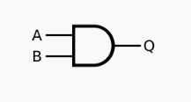
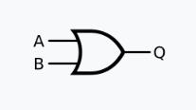
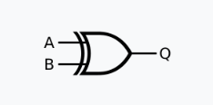
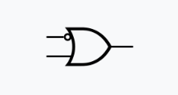
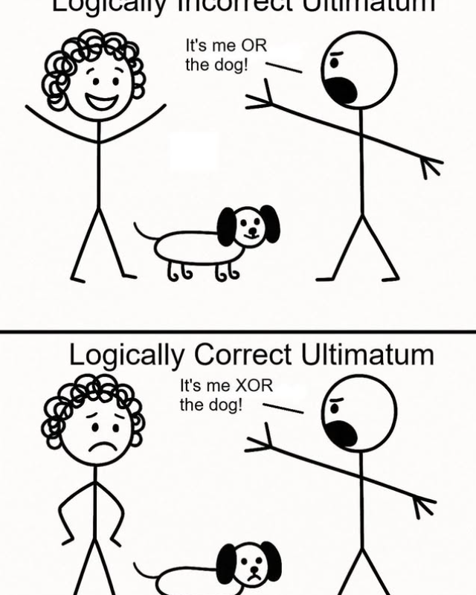
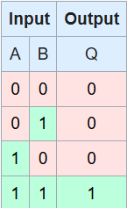
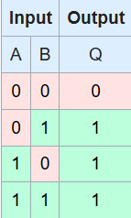
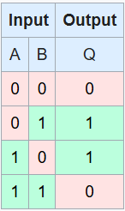
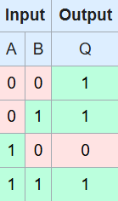
Aside: Logic Gates
AND
OR
XOR
IMPLY

Slide 26
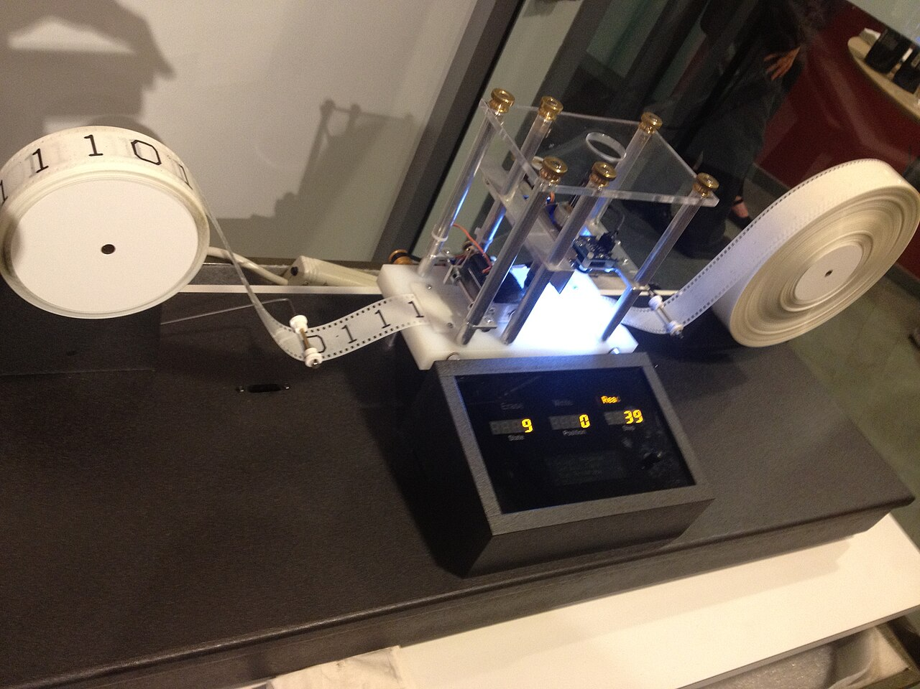
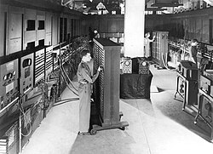
Brief History of AI
Realization of Turing’s machine
Current state, input can perform certain transitions to new state
Stored program computer
Supercomputers in the 1940s
Colossal machines meant to replicate Turing’s machine
In the 1960s, first applications to medicine begin.

Slide 27
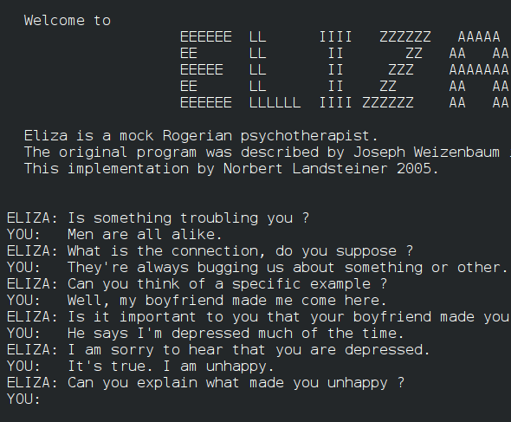
1960s: ELIZA
First “chatterbot”
Psychotherapy bot
Looks for keywords, then flips question back to user
Logic to restructure sentences, ask questions based on certain keywords
First time Turing test was passed

Slide 28
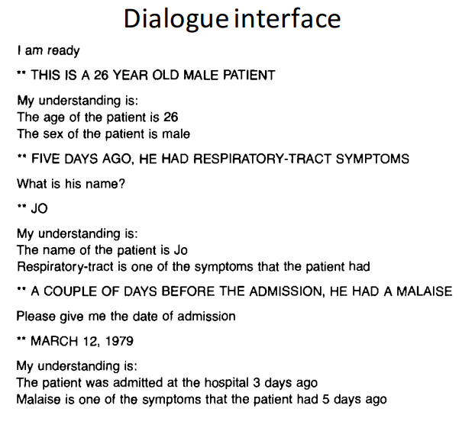
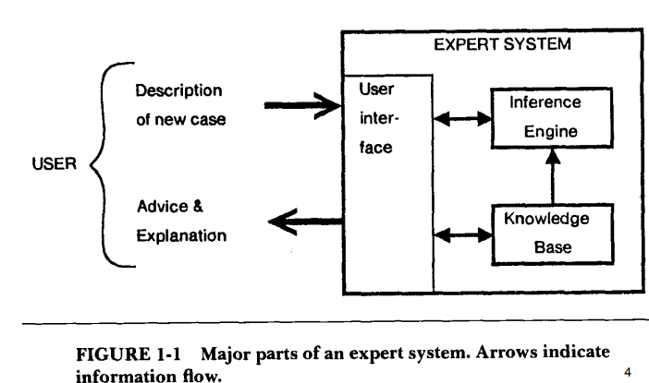
1970’s: MYCIN system
1970’s (Stanford): MYCIN expert
System for identifying bacteremia
Proposed a good therapy in ~69% of cases.
Thanks to MIT 6.S867 for these slides.
Notes:
Rule based system – structures info, then goes through a chain of logical steps to deduce the bacteria at cause and the appropriate abx
If patient has fever, jaundice, ruq pain ->
Then, patient has… cholecystitis.

Slide 29
1970’s: MYCIN system
If: Patient with streptococcal bacteremia
If: patient allergic to penicillin
Back to knowledge base
Yes
No
Then: treat with erythromycin or clindamycin
Then: treat with Penicillin V
Notes:
Of course, just a snapshot that left out many intermediate questions.

Slide 30
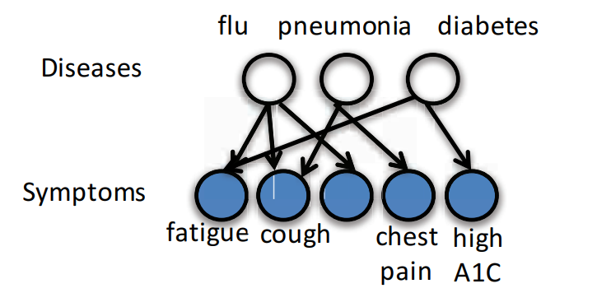
1980s: INTERNIST-1/Quick Medical Reference
Internal Medicine diagnostic model
Probabilistic model relating:
570 disease variables
4075 binary (yes/no) symptom variables
45470 connections
Thanks to MIT 6.S867 for these slides.
Notes:
Issues: (let students try)
Manual symptom entry
Difficult to generalize

Slide 31
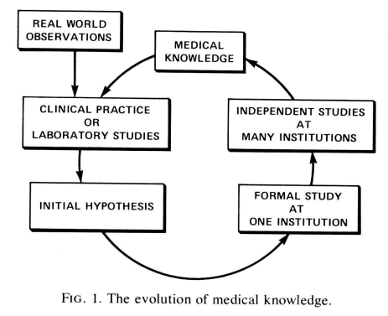
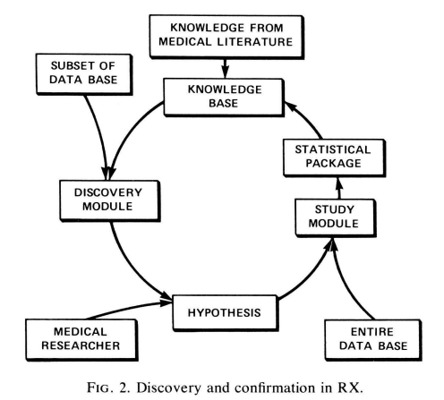
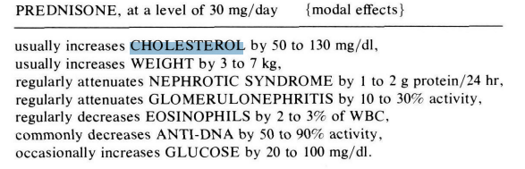
1980’s: The RX Project
Thanks to MIT 6.S867 for these slides.
Notes:
Study out of Stanford,
Hypothesis based if:then architecture which continually updates a knowledge base

Slide 32
Trend
Notice the trend over time: moving from fixed rules to more probabilistic
This will continue into 21st century as we move into next lecture
What does this say about intelligence, knowledge?
Notes:
Can we model everything with fixed rules?
How do we say “I don’t know?”
How can we model “intuition?”

Slide 33
Timeline
Rules
1980s
Probabilities
1990s
Classical ML
2000s
Deep Learning
2010s
Foundation models
2020s

Slide 34
Timeline
Rules
1980s
Probabilities
1990s
???
2000s
???
2010s
???
2020s

Slide 35
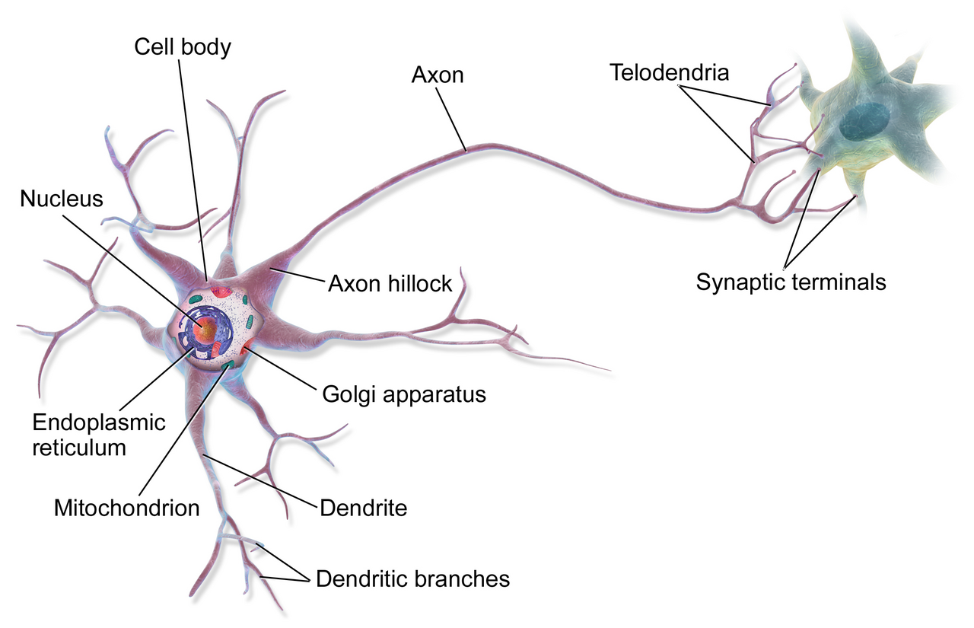
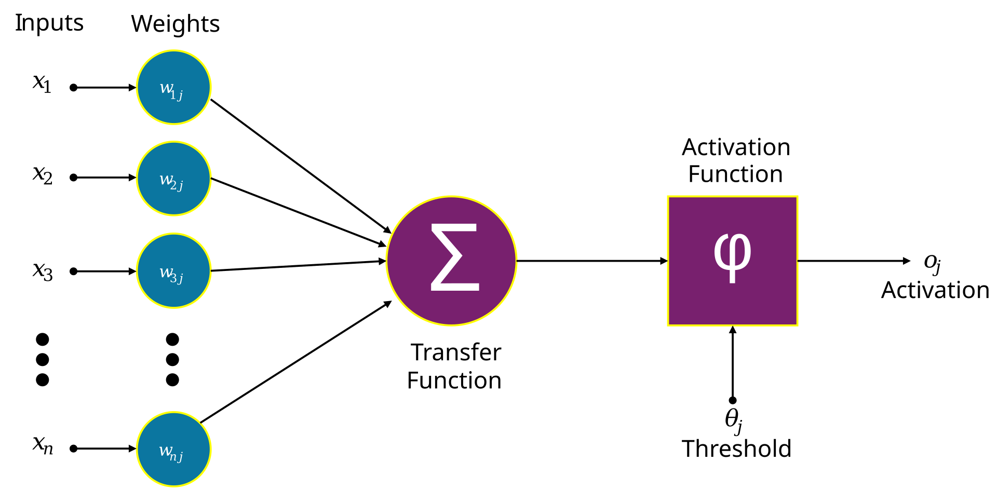
Medicine Inspires AI
1940s – The neuron cell is discovered
Computer scientists wonder – can this be replicated to form the basis of Artificial intelligence?
Notes:
Dendrite, cell body, axon

Slide 36
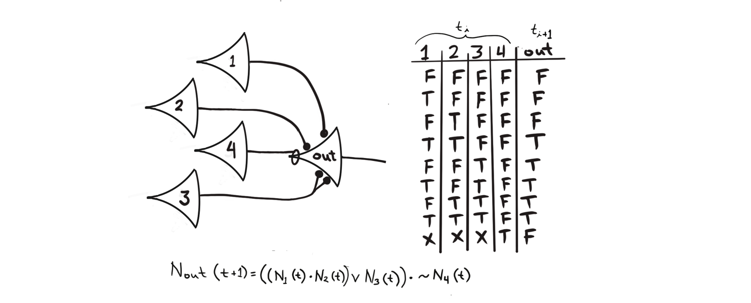
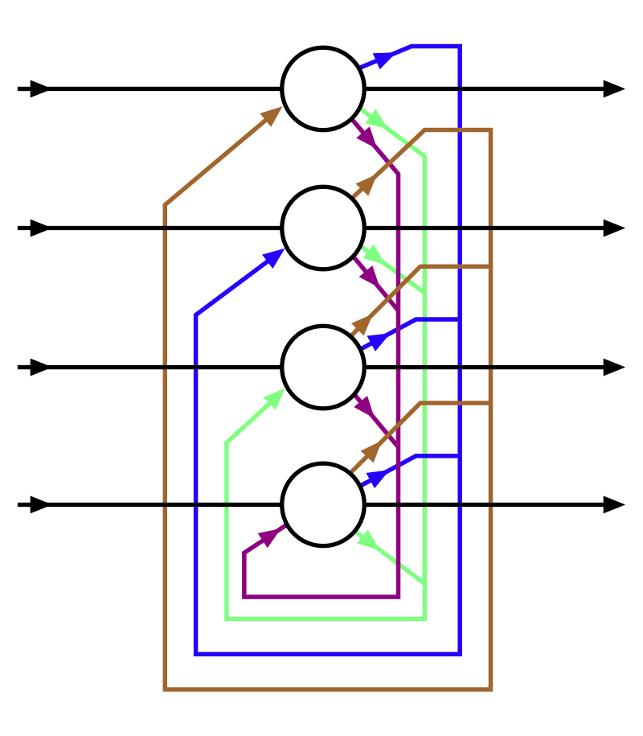
1960s: The Artificial Neural Network
Hopfield network
Notes:
Various inputs lead to outputs
Inhibitory neuron 4 cancels whole output
Problem: How do we create these, and how do we learn?
How many? What connections? What network?
How do you handle varied inputs?
Hopfield net: introduced the idea of a “threshold potential” from biology

Slide 37
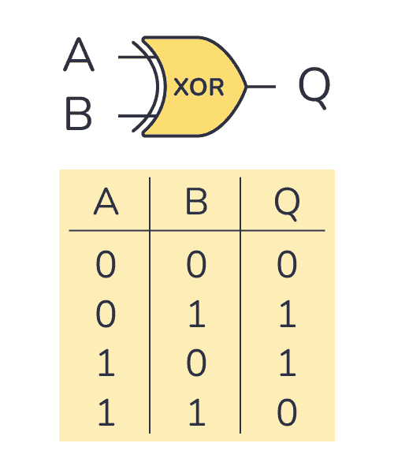
Limitations
Cannot model certain functions
Takes many, many neurons to model
Sounds great in theory, but not effective in practice
How do you set a global learning objective?
How do we set a goal and get better at it?
Notes:
Do you take the setting that gives the desired output for a given input? If so, how do you find states for these neurons? There are too many!

Slide 38
1980s/1990s: Backpropagation
We’ll pick up here next lecture…

Slide 39
Thanks!

